Slide 1

Boolean Algebras and
Boolean Functions

Slide 2

Boolean algebras and Boolean functions

Slide 3
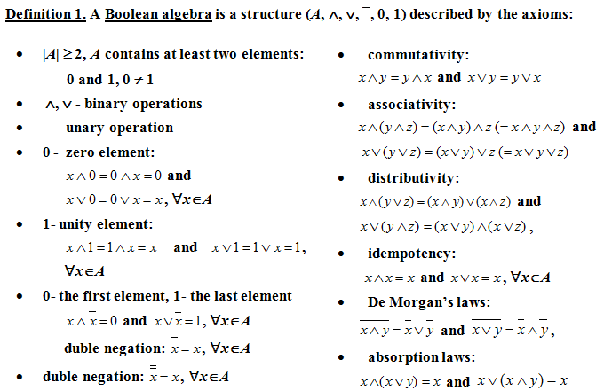
Boolean Algebra

Slide 4
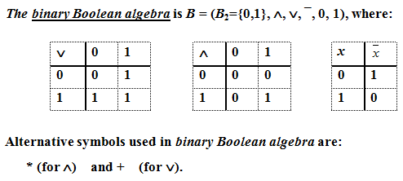
Example 1

Slide 5
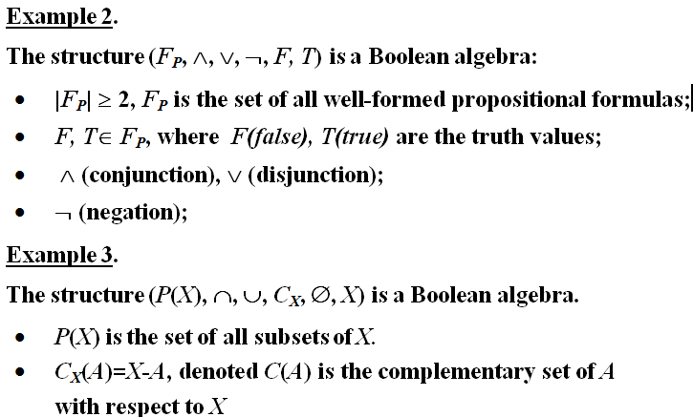

Slide 6
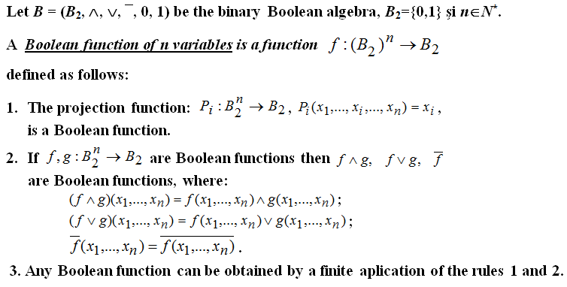
Boolean functions

Slide 7
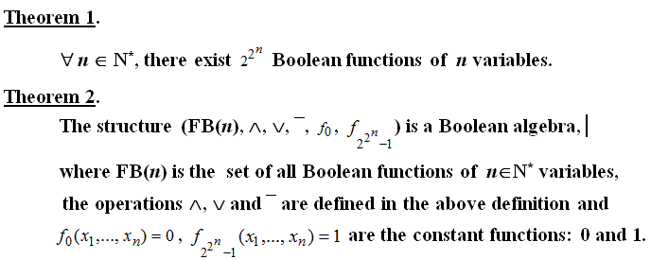
Theorems

Slide 8

Example 4

Slide 9

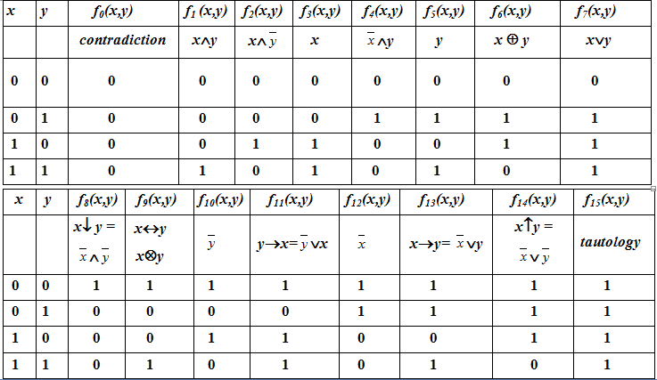

Slide 10
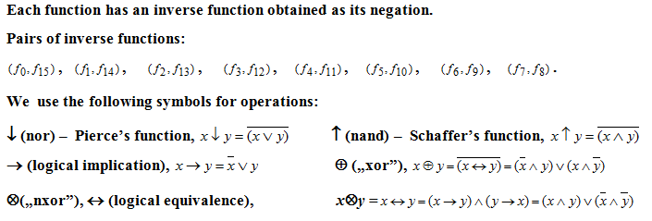
Example 5 (contd.)

Slide 11
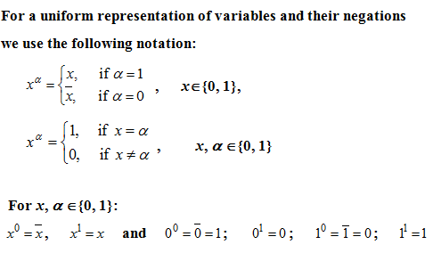
Notations

Slide 12
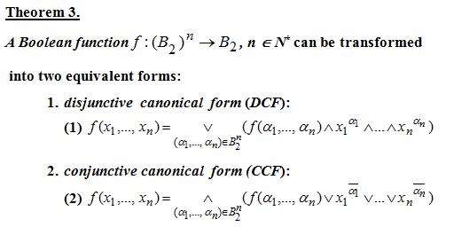
Canonical forms of Boolean functions

Slide 13
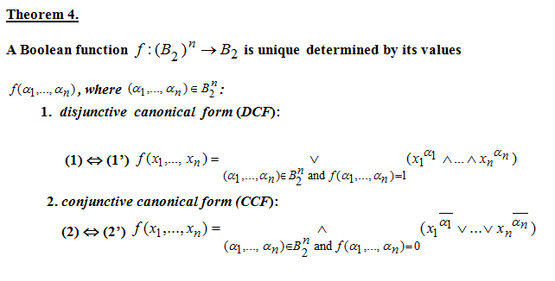
Canonical forms of Boolean functions

Slide 14
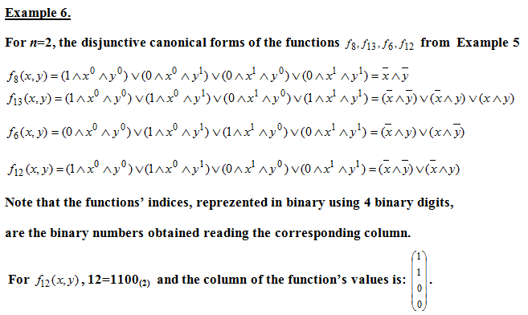

Slide 15
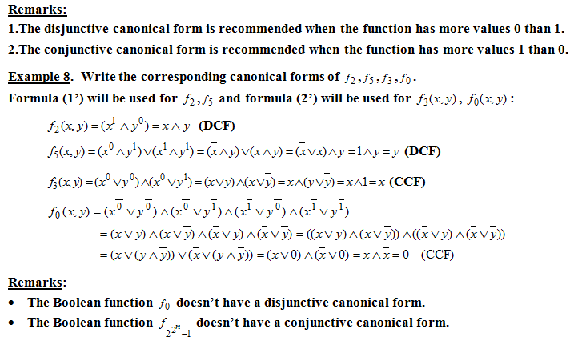

Slide 16
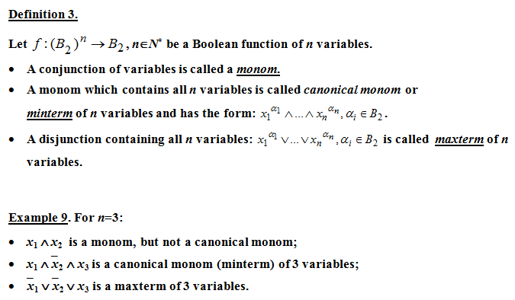
Minterms and Maxterms

Slide 17
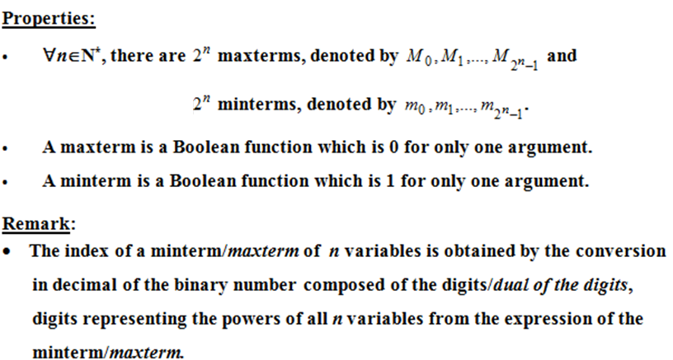
Minterms and maxterms - properties

Slide 19
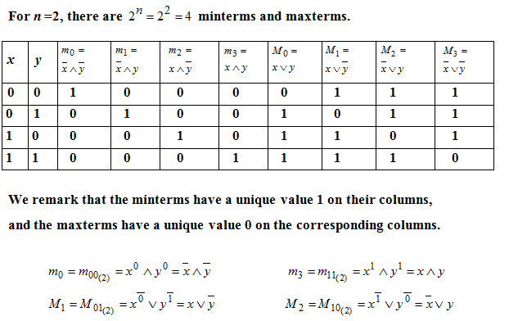
Example 10

Slide 20
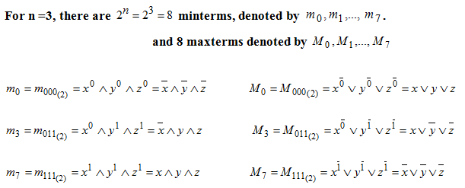
Example 11

Slide 21
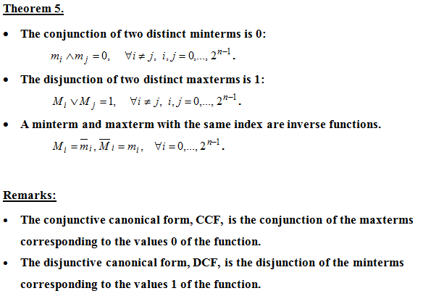

Slide 22
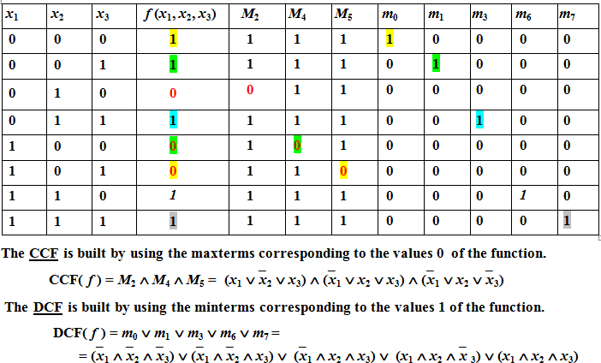
Example 12
Write the canonical forms of the function.

